Slide 1
Personal Development

Slide 2
Why Personal Development?
The very best people invest in themselves
Enable you to grow
Being aware of your strengths
Develop these
To create a journey
To go on the right direction
But you need the right mindset …….

Slide 3
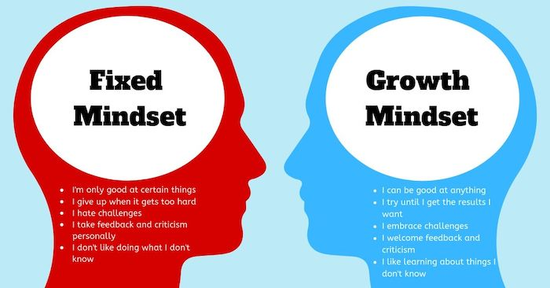
Growth Mindset
https://www.ted.com/talks/carol_dweck_the_power_of_believing_that_you_can_improve?language=en

Slide 4
So what do we cover….
Building your journey
1-2-1’s - Technically / Personally
CV’s
Social Profiles
Interview Preparation
Resources
Ongoing support

Slide 5

Your Journey - Exercise
What does success look like to you
What do you want
Your journey
Where are you now
Such as achievements or skills

Slide 6
Your Journey Exercise
Where are you now?
Skills
Role
Qualities
Achievement
What does success look like to you?
Where do you want to be
Where you want to develop
What do you want to achieve
Skills / behaviours

Slide 7
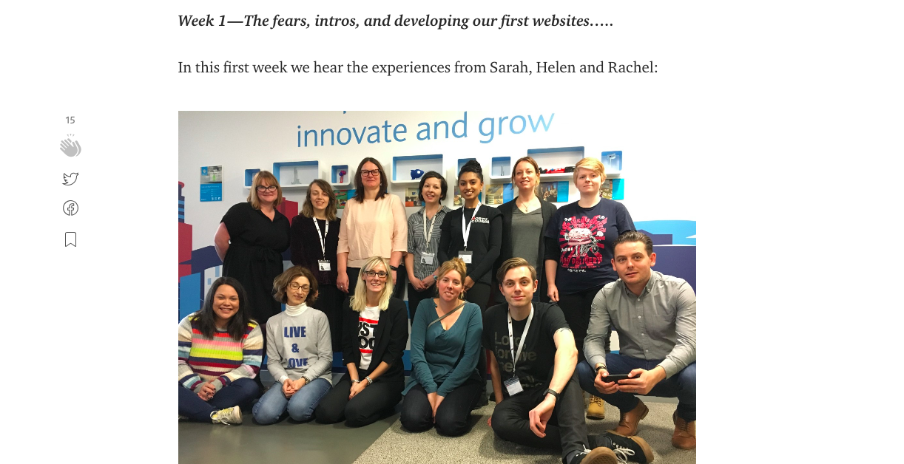
Most importantly…..
Reflect!

